Slide 1
Group 4 Network Science
PPI Pathways
Yulia Zaikina
Katalin Maricza
Karen Torres
Levente Tyukodi
Balázs István Formanek

Slide 2

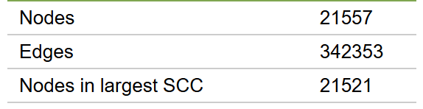
Human protein-protein interaction network
1394: symbol: CRHR1
name: corticotropin releasing hormone receptor 1
2778: symbol: GNAS
name: GNAS complex locus
6331: symbol': SCN5A
name: sodium voltage-gated channel alpha subunit 5
 | node1 | node2
0 | 1394 | 2778
1 | 6331 | 17999
2 | 122704 | 54460
3 | 2597 | 2911
4 | 4790 | 79155
Entrez ID
Protein-Disease Associations
Notes:
This is protein-protein interaction network that contains physical interactions between proteins that are experimentally documented in humans, such as metabolic enzyme-coupled interactions and signaling interactions. Nodes represent human proteins and edges represent physical interaction between proteins in a human cell.

Slide 3
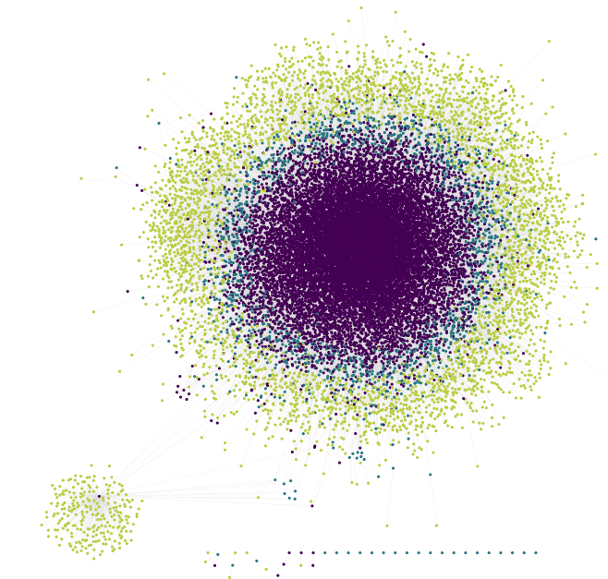
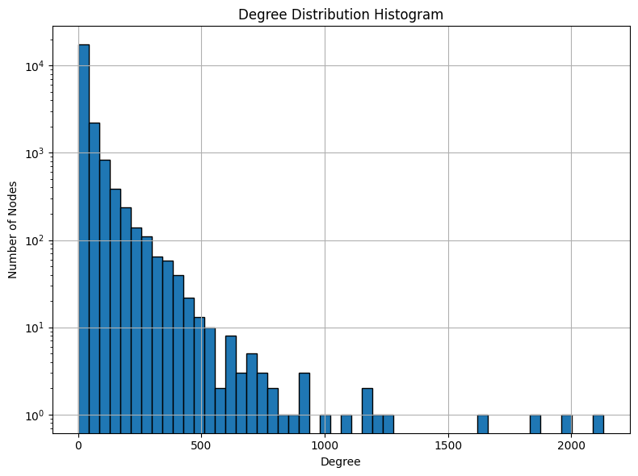
Real World Network
How to extract useful information from the network?
Notes:
This is protein-protein interaction network that contains physical interactions between proteins that are experimentally documented in humans, such as metabolic enzyme-coupled interactions and signaling interactions. Nodes represent human proteins and edges represent physical interaction between proteins in a human cell.

Slide 4
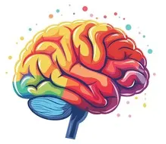
Objective: Brain Diseases Network Subgraph
Why the brain?
Brain sampling and essays limited, refining by expression data
Detect common proteins
Substrate related and addiction
Neurodegenerative and neuroinflammatory disorders
Compare network topology metrics
Neuropsychiatric and behavioural disorders
Shared protein hubs or cross-module connectors
Brain Tumors
Notes:
PPI Network pathways for Brain associated diseases with the purpose of identifying key proteins and their functional relationship with the diseases.

Slide 5
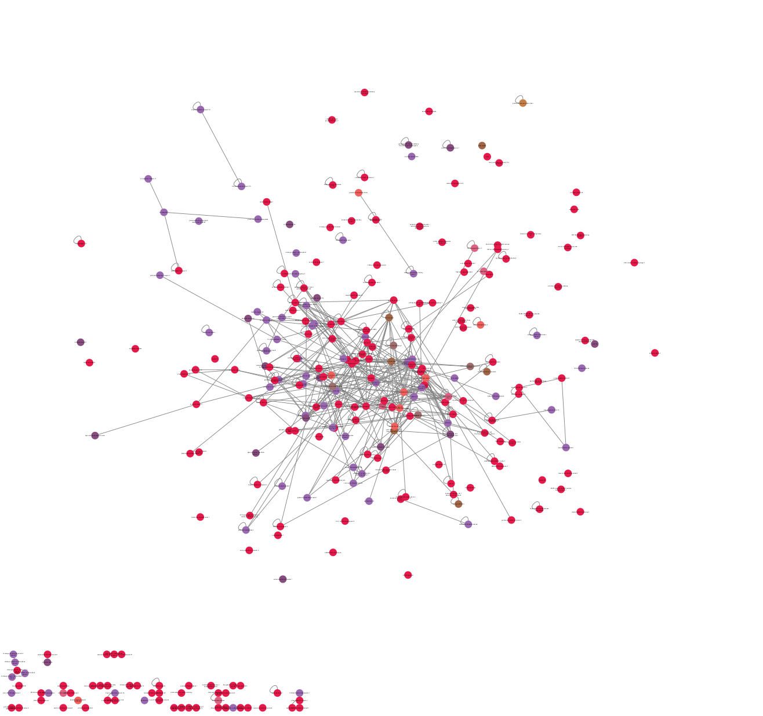
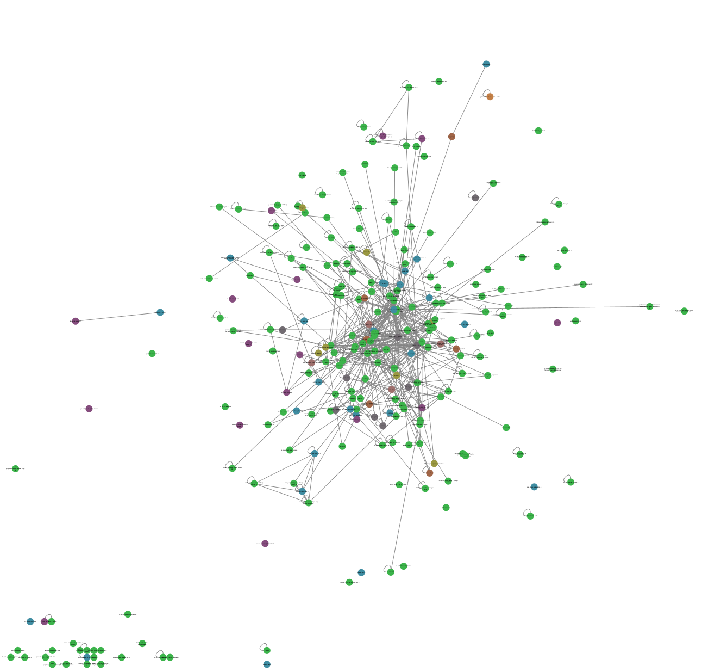
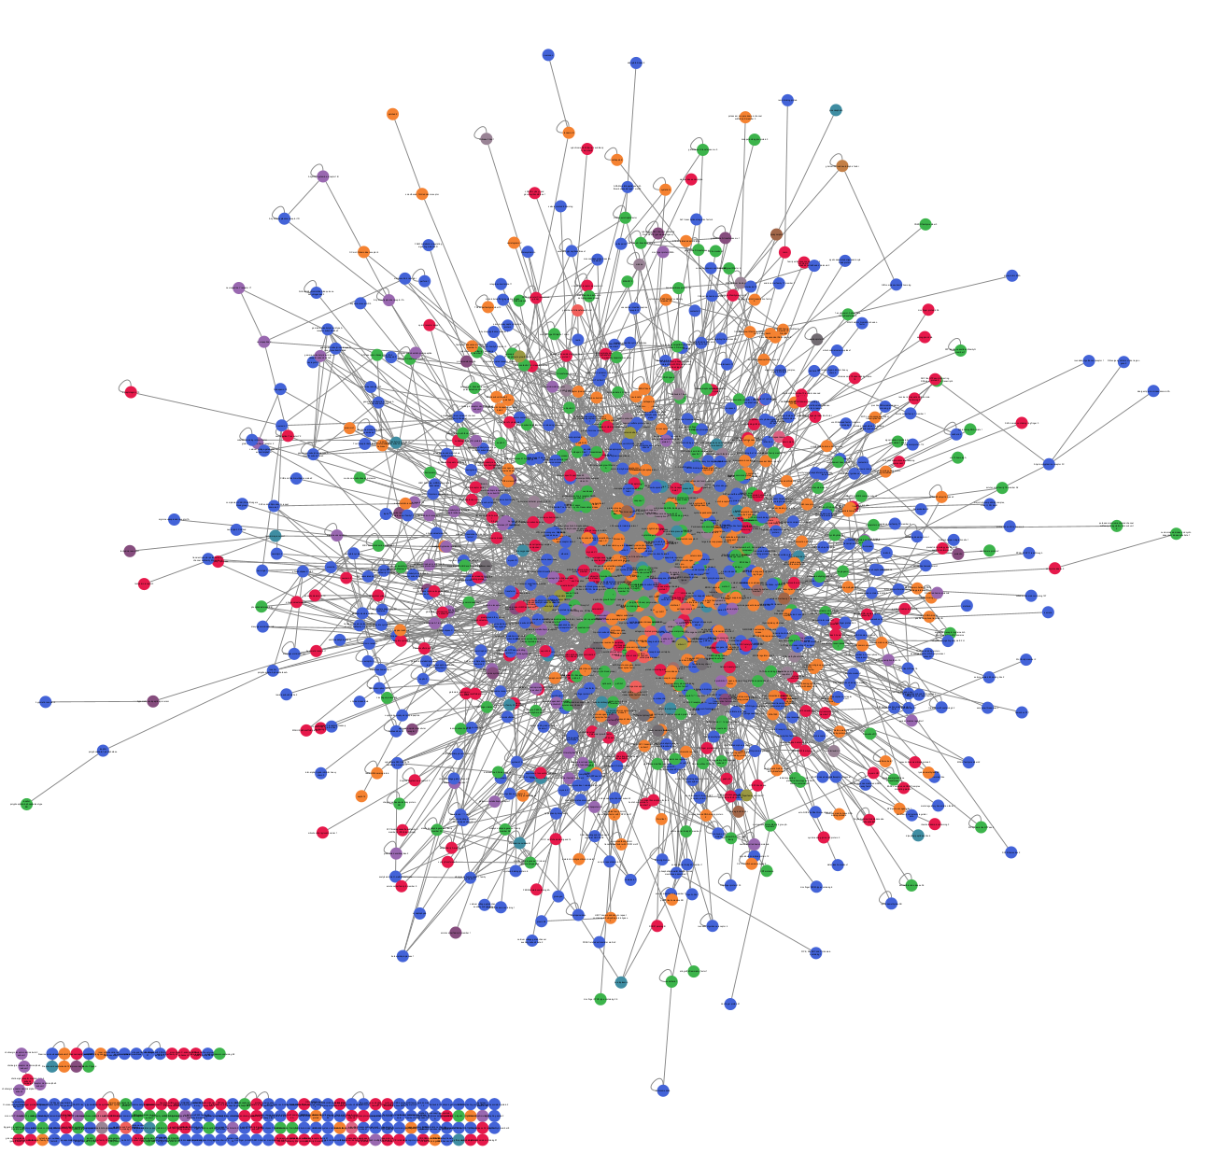
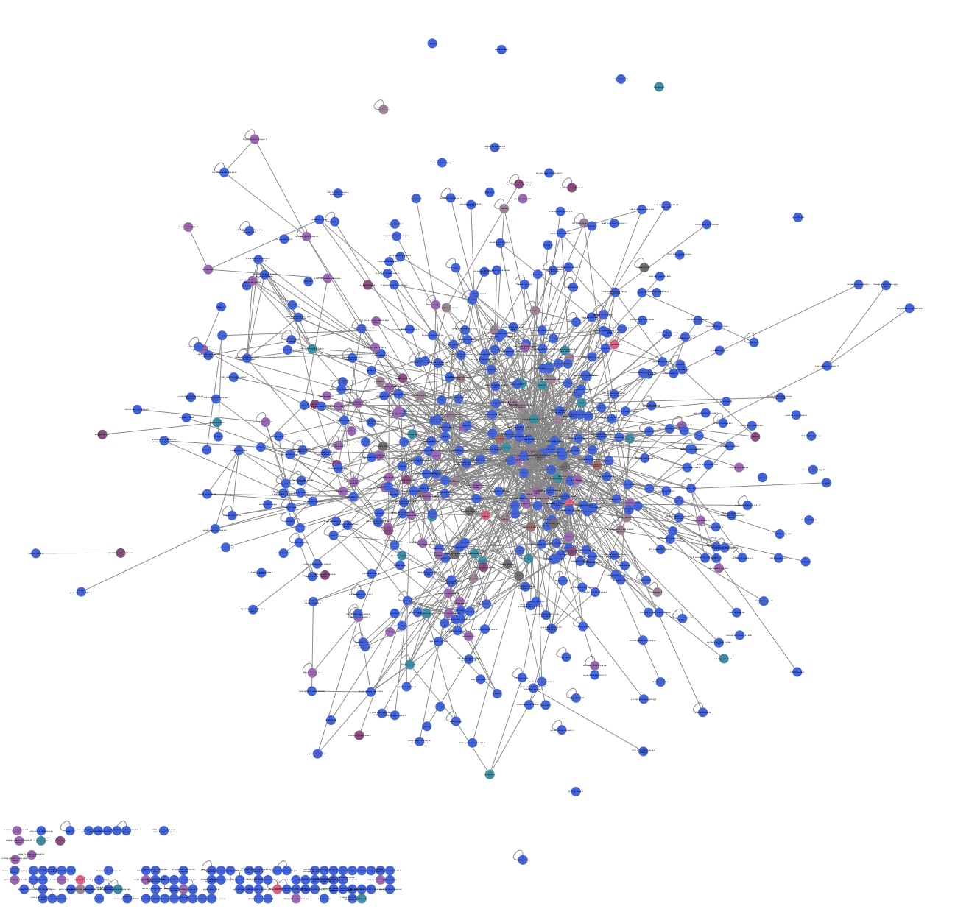
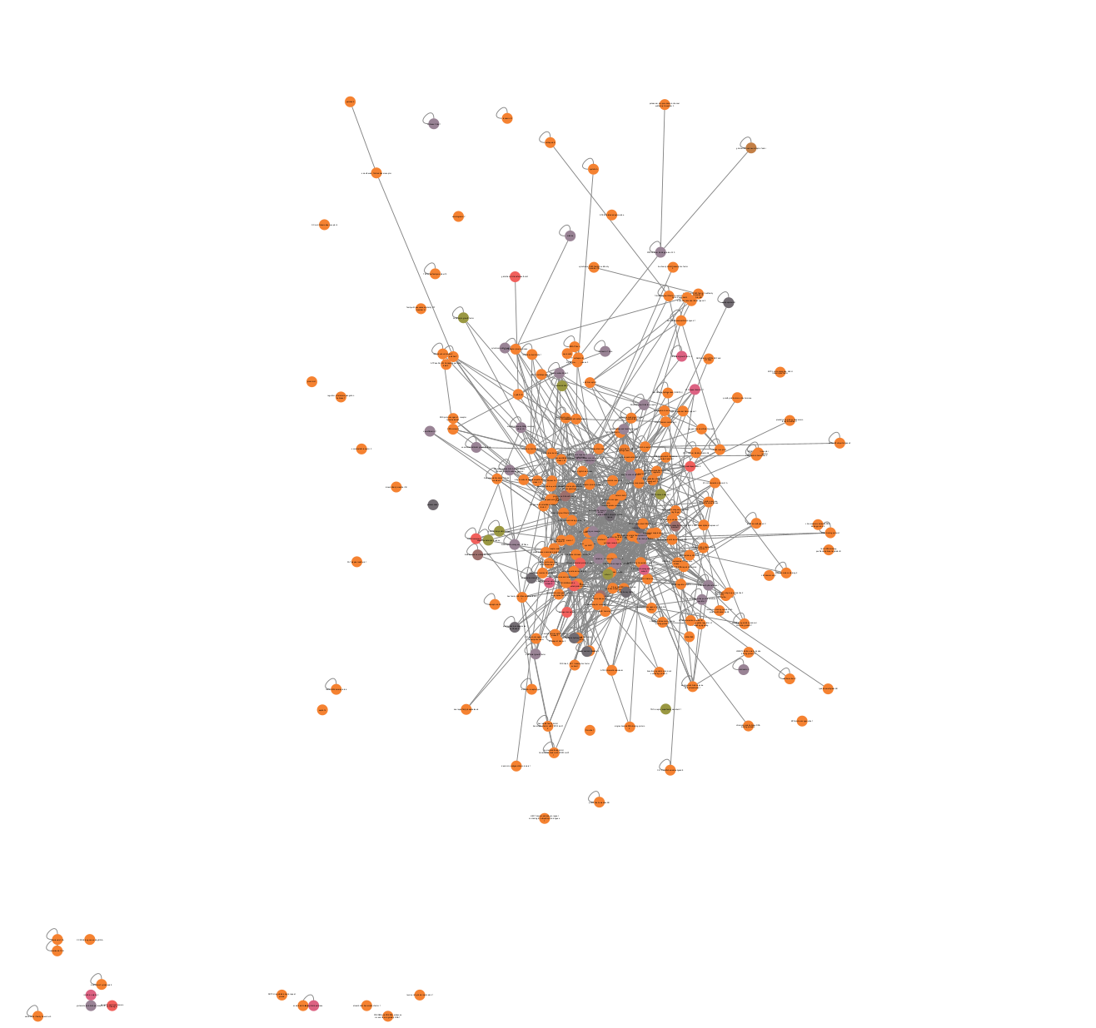
Addiction
Neurodegenerative
Brain disease
related subgraph
Psychiatric
Tumors
Notes:
The centrality of the data remains unaffected despite the reduction in the number of nodes used for the new network. The degree distribution remains consistent, and now we can see four different networks corresponding to each disease group. There is a clear overlap between the networks, so the next step was to identify clusters of proteins that participate in multiple groups and could provide relevant therapeutic insights.
The highest degree proteins all associated with cancer pathogenesis
Node ID: 351, Degree: 159, Symbol: APP, Name: amyloid beta precursor protein
Node ID: 4914, Degree: 152, Symbol: NTRK1, Name: neurotrophic receptor tyrosine kinase 1
Node ID: 7157, Degree: 121, Symbol: TP53, Name: tumor protein p53
Node ID: 2099, Degree: 106, Symbol: ESR1, Name: estrogen receptor 1
Node ID: 1956, Degree: 102, Symbol: EGFR, Name: epidermal growth factor receptor

Slide 6
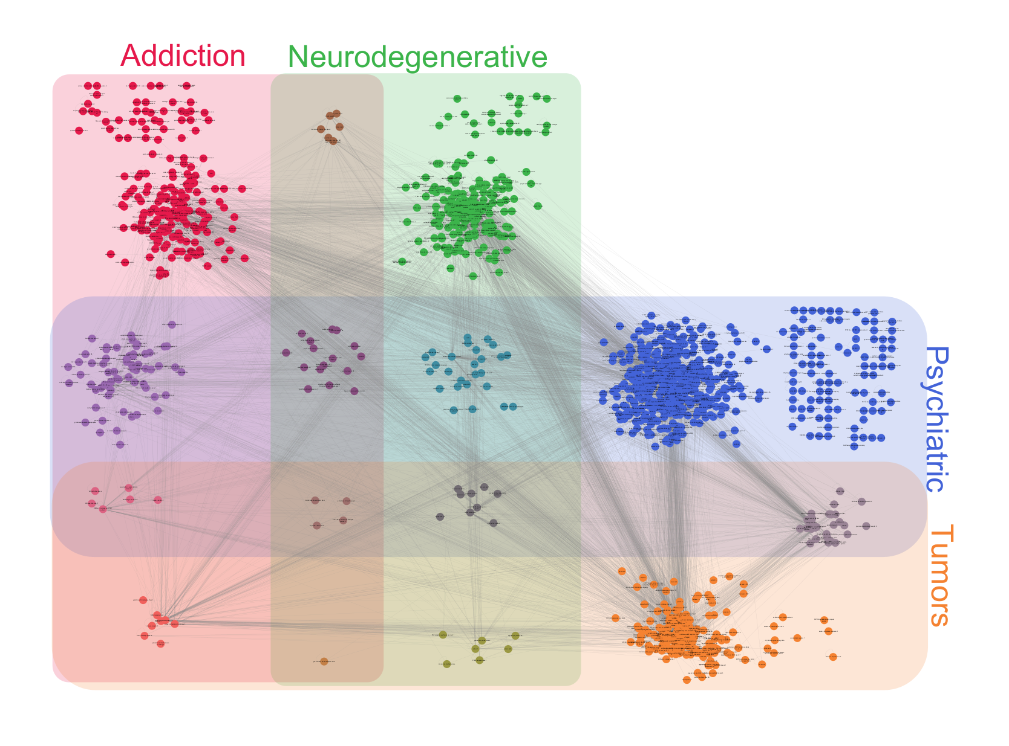
Brain network - connections, network
Notes:
We used cytoscape to present the protein interactions. The most connections appear around the psychiatric disorders related group. The high number of shared or directly interacting proteins suggests that the underlying molecular mechanisms may involve overlapping pathways. Lets see the nodes and the groups without the edges.

Slide 7
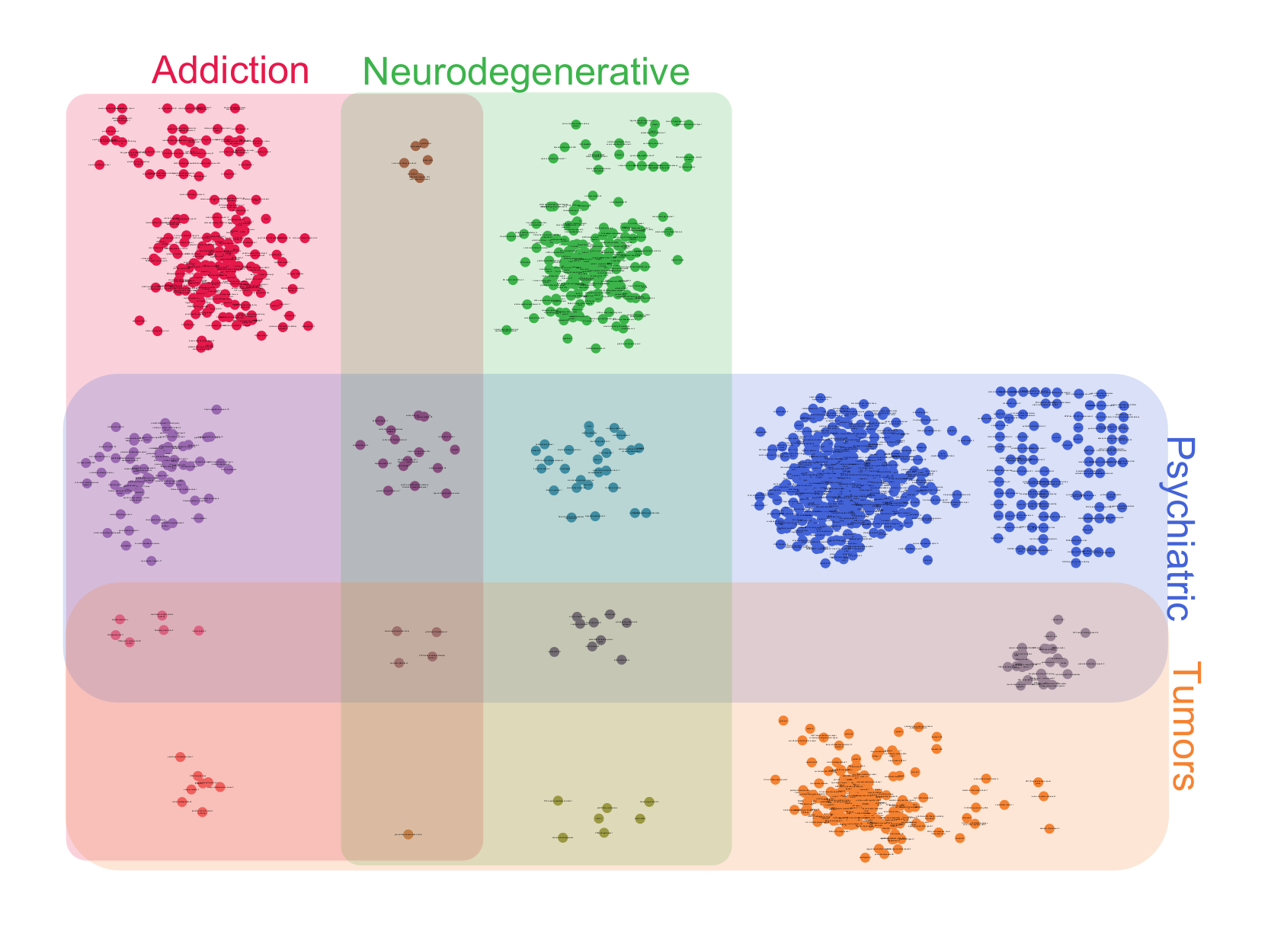
Brain Network Classification
Addiction: 284 nodes
182
6
182
Neurodegenerative: 251 nodes
Psychiatric: 632 nodes
61
16
26
493
Tumors: 241 nodes
6
4
9
17
8
1
7
189
Notes:
There is a relatively similar number of edges for the ONLY addiction, neurodegenerative, and tumor groups.
Here I could talk about each cross-section for tens of minutes, but because of the short time we have to choose the 4 proteins that occur in each group. These proteins interacted with proteins across all disease groups, prompting us to manually investigate their functions and determine how they might be involved in such a diverse range of interactions.

Slide 8
Proteins related to all groups: 4
BDNF
Brain derived neurotrophic factor
Clustering: 0.047, degree: 22,
Neuronal function and synaptic plasticity
ABCB1
ATP binding cassette subfamily B member 1
Clustering: 0.069, degree: 31
Drug and xenobiotic transport across BBB
SOD2
Superoxide dismutase 2
Clustering: 0.061, degree: 114
Oxidative stress defense mechanisms
GSTP1
Glutathione S-transferase pi 1
Clustering: 0.090, degree: 69
Oxidative stress defense mechanisms
Notes:
BDNF is well known protein, which plays a key role in synaptic plasticity and may be an important target for therapeutic studies. ABC transporter responsible for transporting drugs and xenobiotics across the blood-brain barrier. SOD2 has the highest degree among the selected proteins.

Slide 9
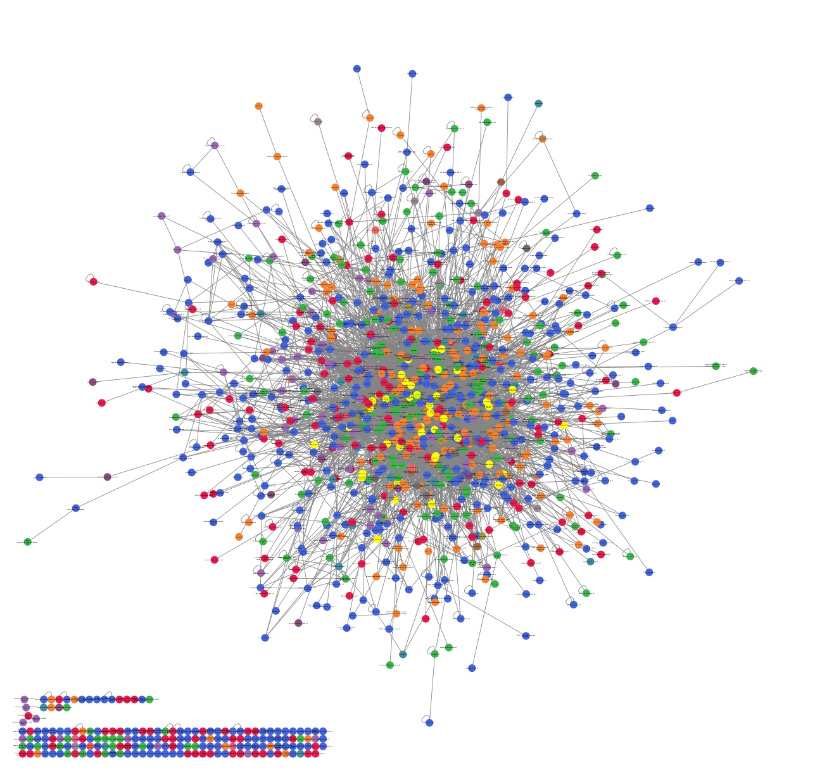
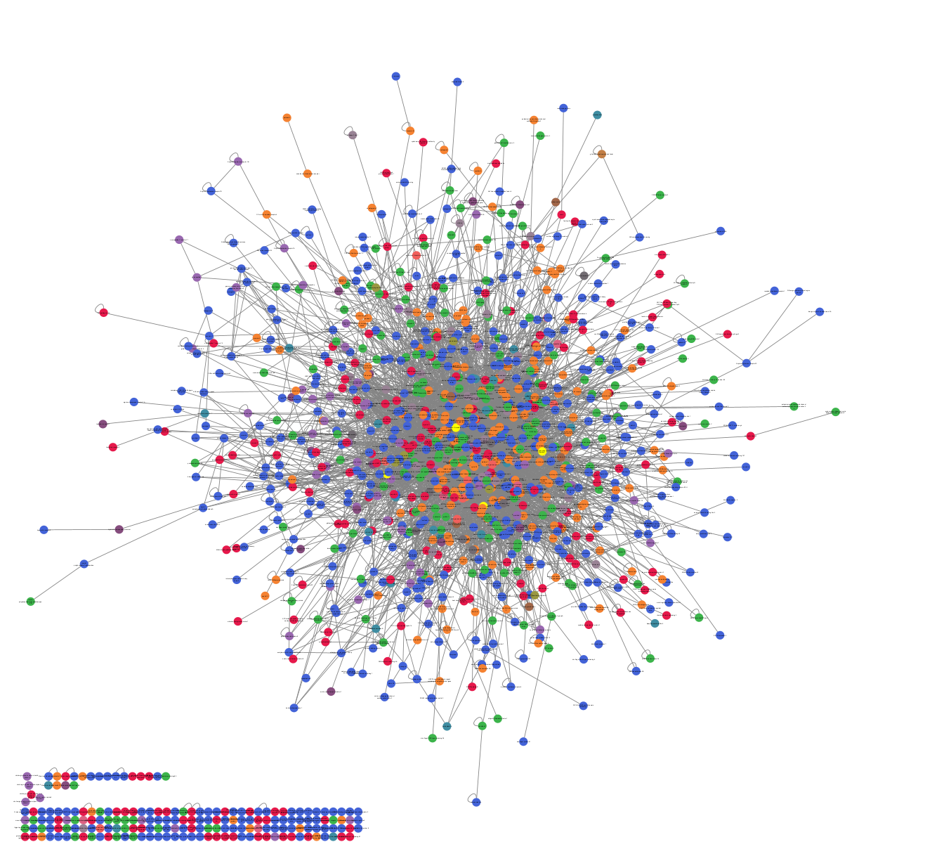
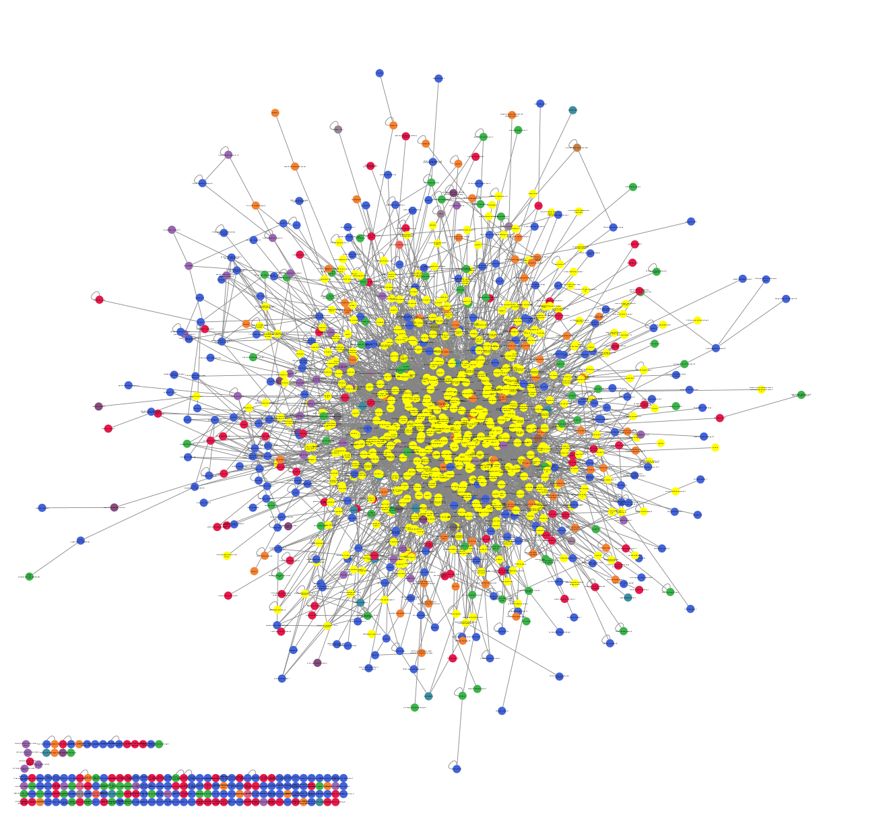
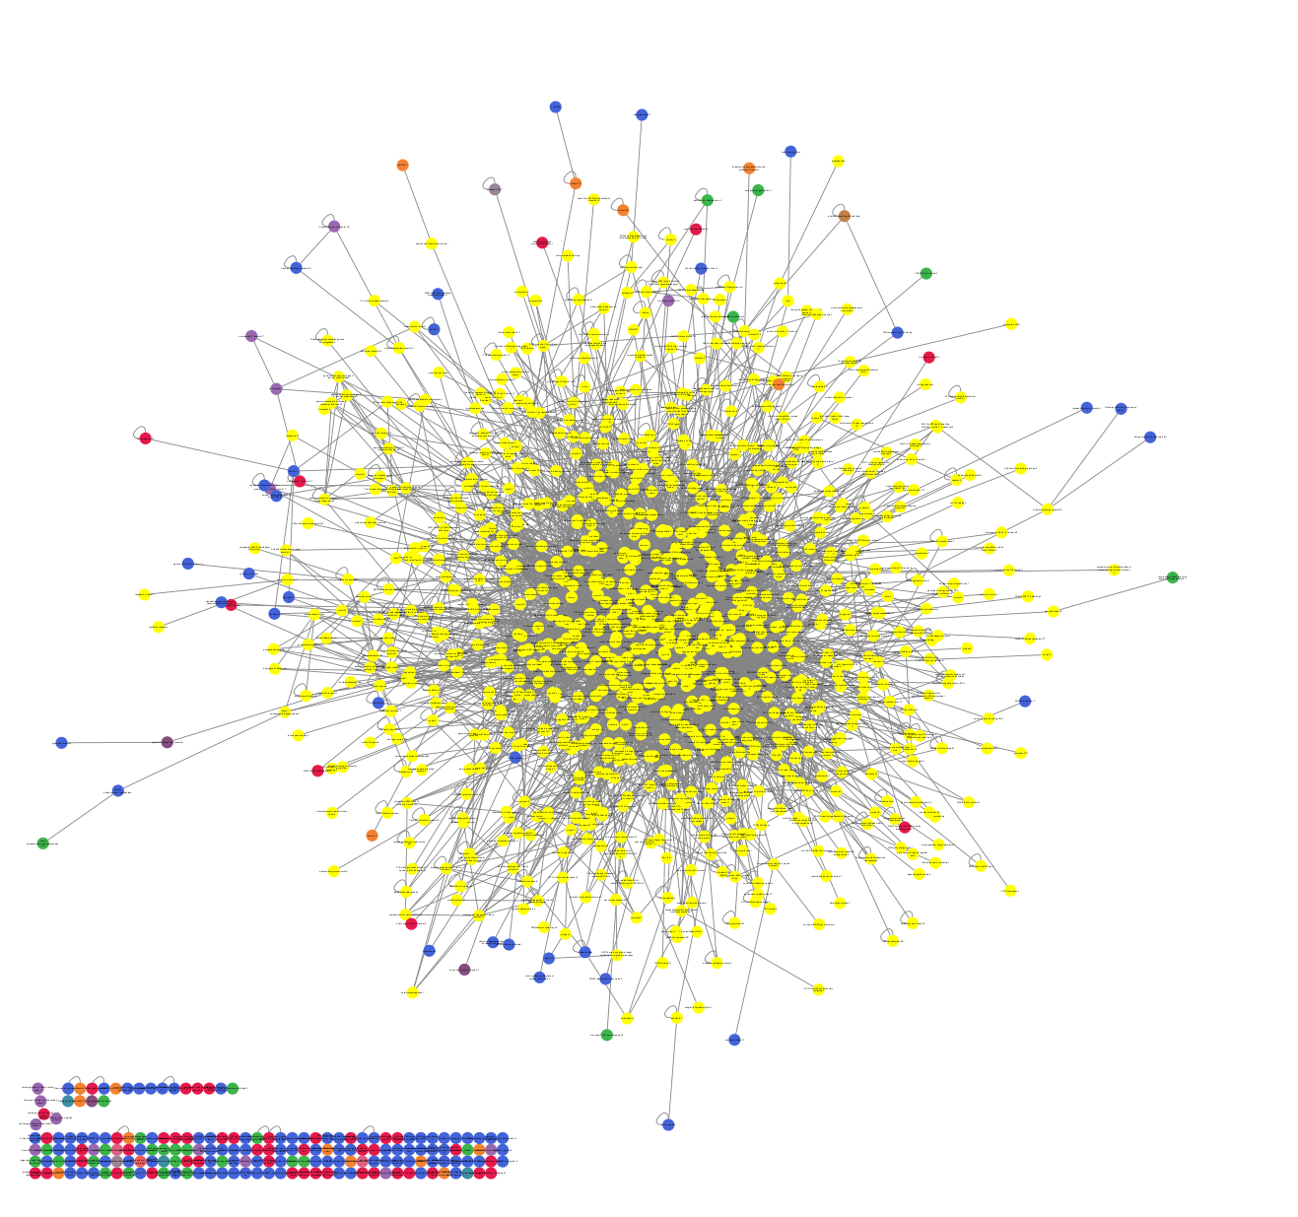
Neighborhood of this proteins
0 distance
4 nodes
2 distance
545 nodes
3 distance
944 nodes
1 distance
42 nodes
Notes:
For a short illustration, we began with four central proteins and progressively added their neighbors, followed by the neighbors of those neighbors. With each layer added, the number of edges increased rapidly, highlighting the network’s expansion and its underlying connectivity pattern. This growth visually demonstrates how even a small set of disease-related proteins can lead to a highly interconnected and complex system.

Slide 10
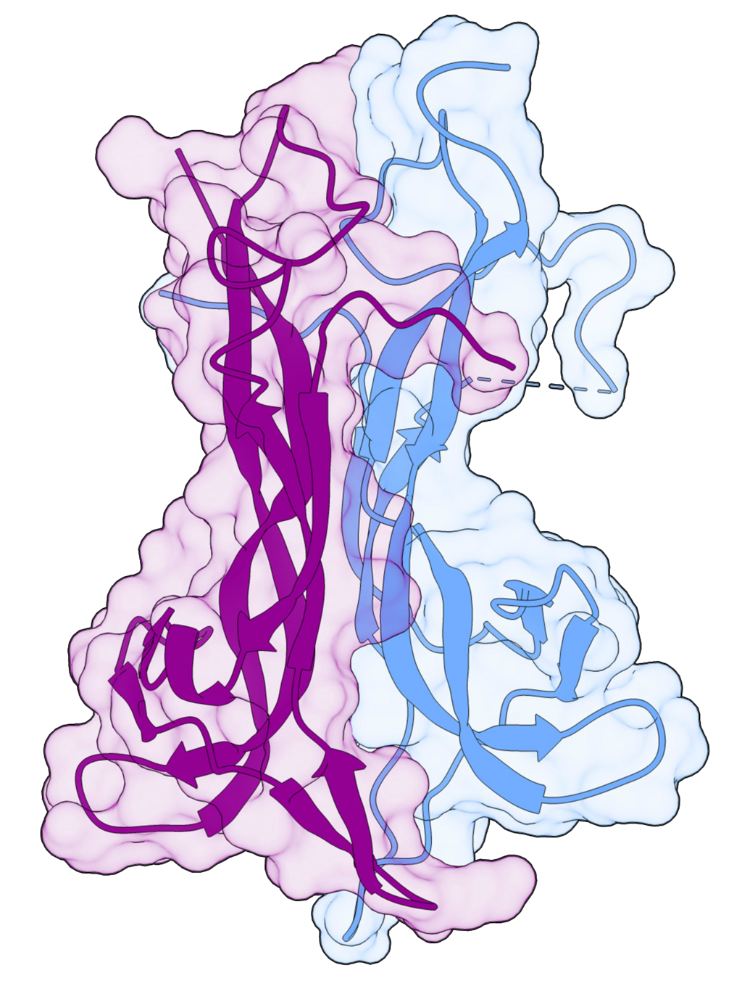
Conclusion
aim -> identify proteins that may serve as key connectors between major brain disease categories
using PPI network analysis, we found overlaps
4 proteins belongs to all groups:
BDNF
ABCB1
SOD2
GSTP1
these central nodes -> explain shared pathophysiological mechanisms -> potential targets
Brain-derived neurotrophic factor
Notes:
Our original aim was to identify proteins that play a key role across different brain disease groups. After the data preparation we hypothesized that such proteins might contribute to shared mechanisms in their pathophysiology. Based on our network analysis and classification, we found several overlaps — and we chose to highlight four central proteins as examples.

Slide 11
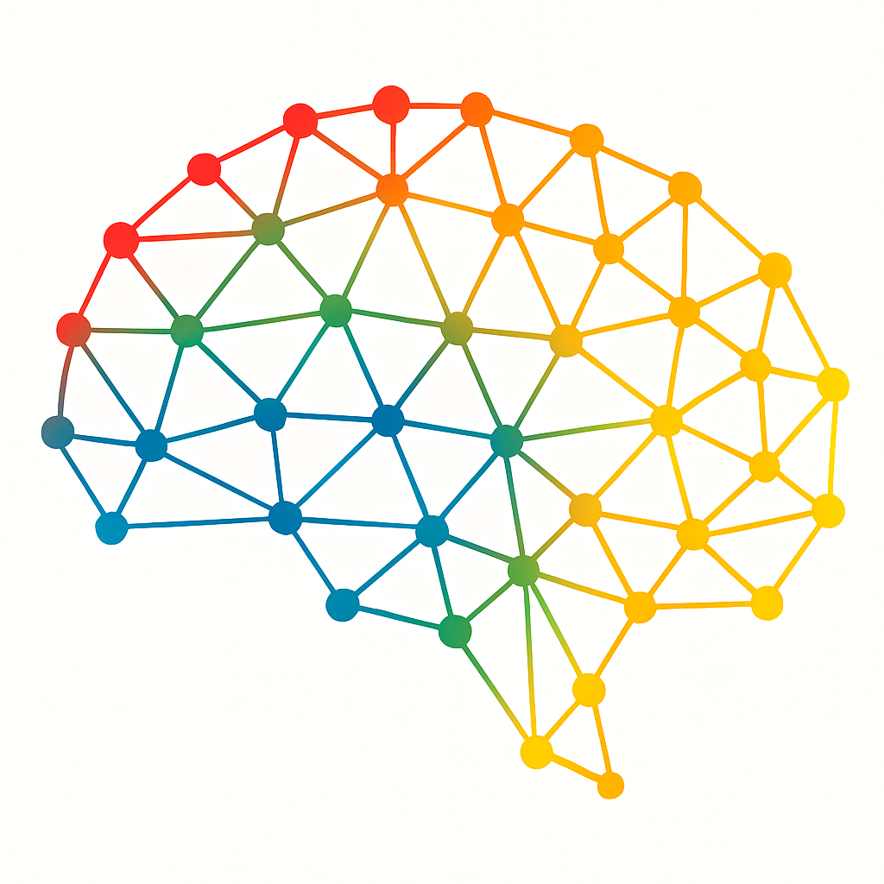
Thank you for your attention!
Notes:
On behalf of our team, we would like to thank the organizers for this opportunity.

Slide 12
References
Large-scale analysis of disease pathways in the human interactome. Monica Agrawal, Marinka Zitnik, and Jure Leskovec. Pacific Symposium on Biocomputing. 2018. (http://psb.stanford.edu/psb-online/proceedings/psb18/agrawal.pdf)
OpenAI. (2025, August). ChatGPT (August 2025 version) [Large language model]. https://chat.openai.com
High throughput protein expression screening in the nervous system – needs and limitations. Chris N. G. Anderson and Seth G. N. Grant. The Journal of Physiology. 2006. (https://doi.org/10.1113/jphysiol.2006.113795)
Further Research of clustering based on tissue: further_analysis_tissues.ipynb

Slide 13
Brain Diseases Grouping
SUBSTANCE RELATED AND ADDICTION marijuana abuse, tobacco use disorder, tobacco addiction, susceptibility to (finding), amphetamine-related disorders, cocaine-related disorders, substance withdrawal syndrome, psychosis, substance-induced, substance-related disorders
NEURODEGENERATIVE, NEUROINFLAMMATORY DISORDERS neurodegenerative disorders, neurogenic inflammation, amyotrophic lateral sclerosis, amyotrophic lateral sclerosis 1, Parkinson disease, Parkinson disease, late-onset, Parkinsonian disorders
NEUROPSYCHIATRIC AND BEHAVIORAL DISORDERS narcolepsy, bipolar disorder, schizophrenia, childhood, autistic disorder, attention deficit hyperactivity disorder, anxiety disorders, major depressive disorder, depressive disorder, panic disorder, mental disorders, cognition disorders, learning disorders, restless legs syndrome, memory disorders, catalepsy
BRAIN TUMORS brain neoplasms, neuroblastoma, glioblastoma, giant cell glioblastoma, glioma, gliosis, gliosarcoma, medulloblastoma, astrocytoma, neuroendocrine tumors

